Slide 1
Wizard of oz or Experience Prototyping

Slide 2
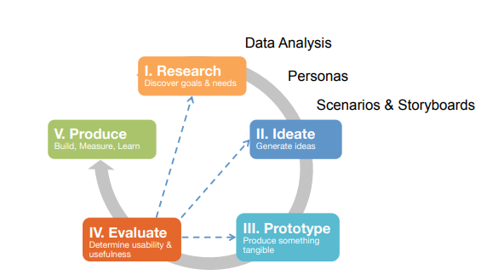

Today’s Agenda

Slide 3
Experience Prototype or Wizard of oz
The key is making the interactions and experience as authentic to the real thing as possible
Typically a Hi-fidelity experience
Wizard of oz saves time and avoid complicated implementation

Slide 4
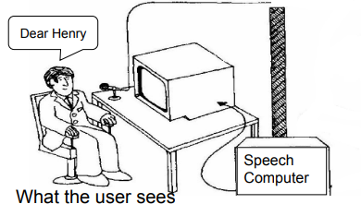
Wizard of Oz (WoZ)
A method of testing a system that does not yet exist

Slide 5
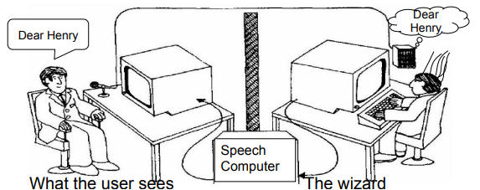
Wizard of Oz
A method of testing a system that does not yet exist

Slide 6
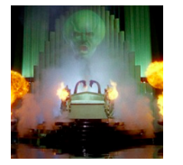
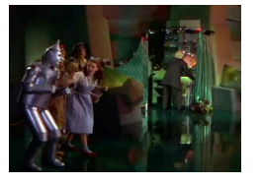
Wizard of Oz (WoZ)
From the movie (http://www.youtube.com/watch?v=NZR64EF3OpA)

Slide 7
Wizard of Oz (WoZ)
Up until the point the wizard is discovered, the thoughts, feelings, and actions of Dorothy and the others were all genuine
They were genuinely experiencing what it would be like to talk to a powerful and terrible wizard

Slide 8
Wizard of Oz (WoZ)
Human ‘wizard’ simulates system response
interprets user input according to an algorithm
controls computer to simulate appropriate output
uses real or mock interface
wizard sometimes visible, sometimes hidden
Good for:
adding simulated and complex vertical functionality
testing futuristic ideas

Slide 9
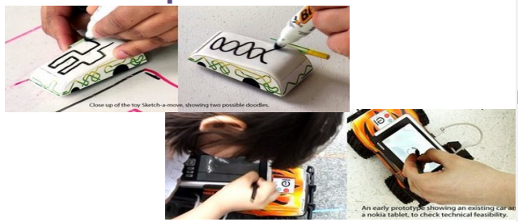
Wizard of Oz (WoZ) Example
Sketch-a-move (http://www.youtube.com/watch?v=O-XNwam3LOs)

Slide 10
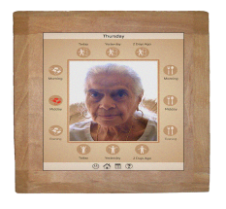
Wizard of Oz (WoZ) Example
CareNet Display (Consolvo et al., 2004)
In-home display shows adult children how their aging parent is doing
Design team called older person daily to collect information and updated display

Slide 11
Wizard of Oz (WoZ) Example
Movie phone (http://www.youtube.com/watch?v=qM79_itR0Nc)

Slide 12
Making an Experience or WoZ Prototype
Map out scenarios and application flow
What should happen in response to user behavior?
Put together interface “skeletons”
Develop “hooks” for wizard input
Where and how the wizard will provide input
Selecting the next screen, entering text, entering a zone, recognizing speech, etc.
Rehearse wizard role with a colleague

Slide 13
Running the WoZ Prototype
Practice with a friend first
Once you are comfortable recruit users
Two roles: facilitator and wizard
Facilitator provides tasks and takes notes
Wizard operates interface (more authentic if hidden or remote)
User Feedback can be
Think aloud (speak freely as performing tasks)
Retrospective (best when think aloud distracts)
Debrief users (reveal wizard if needed)

Slide 14
Exercise: Order a shoes for yourself
REI shop (https://www.rei.com/stores/castleton)

Slide 15
Think Aloud

